Slide 1
Animation

Slide 2
Table of Content
Definition of animation.
Types of animation.
Common techniques of animation.
3-D animation.
Animation special effects.
Kinematics
Inverse kinematics.
Animation -12 Principals.
Animation file formats.

Slide 3
Definition of Animation
Animation is the rapid display of a sequence of images of artwork or model positions or frames in order to create an illusion of movement.
Animation starts with independent pictures and puts them together to form the illusion of continuous motion.

Slide 4
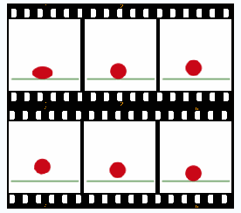

Definition of Animation

Slide 5
How does animation work?
If you view a series of related still images in quick succession, your brain perceives them as continuous motion.
In animation jargon, each image is called a frame.
Movement is actually made up of many frames.

Slide 6
How does animation work?
An object seen by the human eye remains chemically mapped on the eye’s retina for a brief time after viewing. This phenomenon is called persistence of vision.
The human mind needs to conceptually complete a perceived action. This phenomenon is called phi.

Slide 7
How does animation work?
Usually, movies will run at 25 to 30 fps but computer animations can run at 12 to 15 fps.
Anything less than 12fps will be jerky motion as the eye is able to detect the changes from one frame to the next.
The frame rate measures the speed of the change. → frames per second

Slide 8
Types of Animation
Bitmap animation
In bitmap animation, the frame bitmaps (every pixel of each frame) are first loaded into the system memory and are then rapidly displayed on the screen from the memory.
Bitmap animation takes huge amount of memory since all pixel information are to be first loaded into memory.
Vector animation
In vector animation, the images for each frame are calculated and generated by the computer.
Vector animation takes up lesser memory space, but more time is generally needed to create the images than to load them from memory or disk.
However, when delivering on the net where file size is a major concern, vector animation is a better choice for simple animation.

Slide 9
Common techniques of animation:
Keyframe animation
Cel-based animation
Path-based animation

Slide 10
Keyframe animation
Historically, the animator has to create every frame of an animation by hand. Depending on the quality, one minute of animation might require between 720 and 1800 separate still images.
Each frame in an animation reflects small changes from the previous frame.
The master artists by having them draw only the important frames, called keyframes.
Junior animators or assistants could then draw the frames that were required in between the keyframes.
The in-between frames are called tweens.

Slide 11
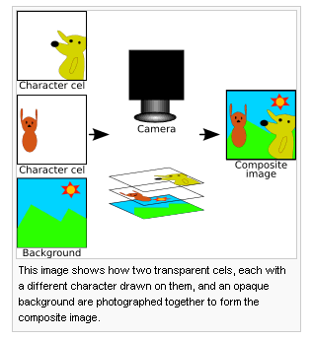
cel animation
Cel comes from the word celluloid (transparent sheet material) used to draw the images and place them on a stationary background.
Background does not change but the object does

Slide 12
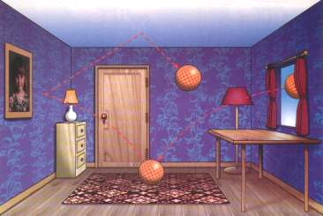
Path animation
Moves an object along a predetermined path - straight line or curve on the screen.
Object does not change although it can be resized or reshaped.
Motion tweening is an example of path animation - keyframes (starting point and the destination point) are set and the program does the in-betweening for you
Tweening: process of generating intermediate frames between two images to give the appearance that the first image evolves smoothly into the second image.

Slide 13
3-D animation
Involves 3 steps:
  Modeling
  Animation
  Rendering

Slide 14
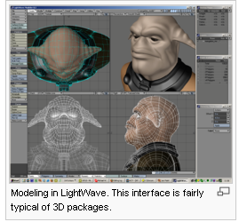
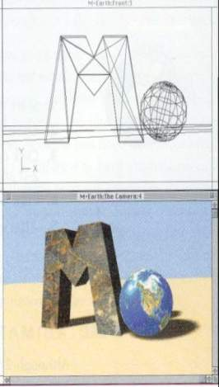
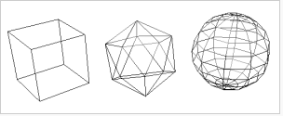
3-D animation
Modeling:
  3D modeling describes the shape of an object
  process of creating 3-D objects and scenes.
  Can involve drawing various views of an object (top, side, cross-section) by setting points on a grid.
  The two most common sources of 3D models are those created by engineer using 3D modeling tool, and those scanned into a computer from real-world objects.

Slide 15
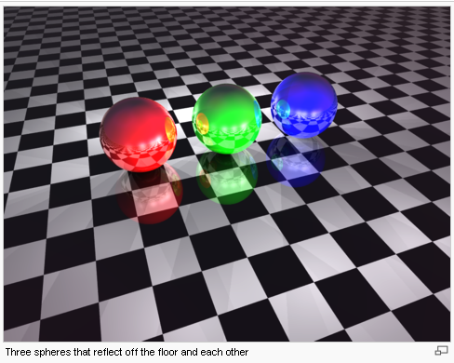
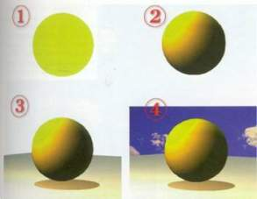
3-D animation
Animation:
  Defining the object's motion and how the lighting and views change during the animation.
    Shadow, shading, ray tracing

Slide 16
3-D animation
Rendering:
  Process of converting models → image using special computer programs.
  Give the final appearance to the models
  Example:
    colors
    surface textures
    degrees of transparency

Slide 17
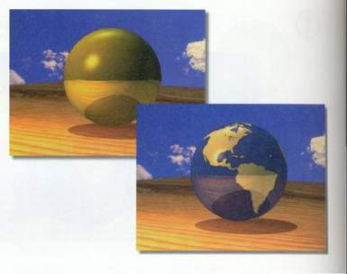
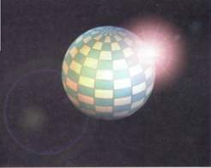
Animation special effects
Ray tracing:
General technique from geometrical optics of modeling the path taken by light by following rays of light as they interact with optical surfaces.

Slide 18
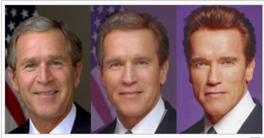
Animation special effects
Morphing:
  Transforms one image into another through a seamless transition .
  Selects sets of corresponding points on each of the images e.g. the eyes, lips, ears and outline of the head.
  Based on these points, pixels are rearranged to transition the original image into the second via a series of intervening images.
http://luisguillermo.com/chavstro/
http://www.blackbeltsystems.com/bw_md.html

Slide 19
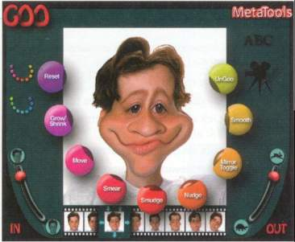
Animation special effects
Warping:
  allows manipulation of a single image
  e.g. can stretch facial feature to change a frown into a smile
http://www.sigmapi-design.com/htmtutor/warp.htm

Slide 20
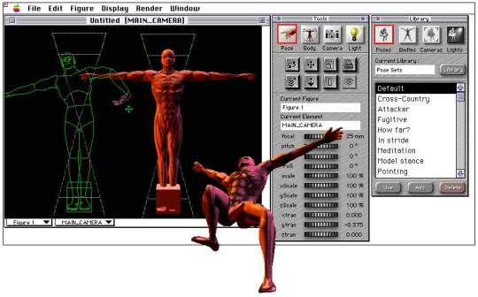
Kinematics – Simulation on Human Motion
Kinematics:
  Study of movement & motion of structures that have joints. (example: a walking man, dinosaur)
  Complex process; calculate the position, rotation, velocity of joints.

Slide 21
Inverse Kinematics
268
Inverse Kinematics:
  Process that links object (eg: hands to arm) to define relationship and limit. (kinematic constraints* & kinematic chain**)
  * Kinematic constraints- example: elbow cannot bend backwards.
  ** Kinematic chain – example: if upper arm moves, lower arm and hand must move with it
Useful for animating jointed structures, especially limbs of human or animal figures

Slide 22
Animation -12 Principals
Squash and Stretch
Timing and Motion
Anticipation
Staging
Follow Through and Overlapping Action
Straight Ahead Action and Pose-To-Pose Action
Slow In and Out
Arcs
Exaggeration
Secondary Action
Appeal
Strong Drawing or Solid Drawing

Slide 23
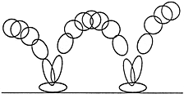

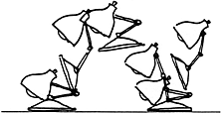
1) Squash and Stretch
Defining the rigidity and mass of an object by distorting its shape during an action.
  Example: ball is softer than a stone
Squash:
  flatten an object because of pressure / power.
Stretch:
  used to increase the sense of speed and emphasize the squash by contrast.

Slide 24
2) Timing and Motion
Timing is the precise moment and the amount of time that a character spends on an action.
Timing adds emotion and intention to the character’s performance .
Weight / Scaling Properties
Timing can also contribute to size and scale of an object or character.
A larger character has more mass, more weight and more inertia than a tiny character, therefore it moves slower.
In contrast, a tiny character has less mass, weight, and inertia, therefore its movements are quicker.

Slide 25



3) Anticipation
An action occurs in three parts:
  preparation for the action,
  the action itself
  termination of the action.
Anticipation -> the preparation for the action.
Anticipation allows the audience has a clue as to what is about to happen.
Example: broad physical gesture, or it can be as simple as an expression or a music

Slide 26
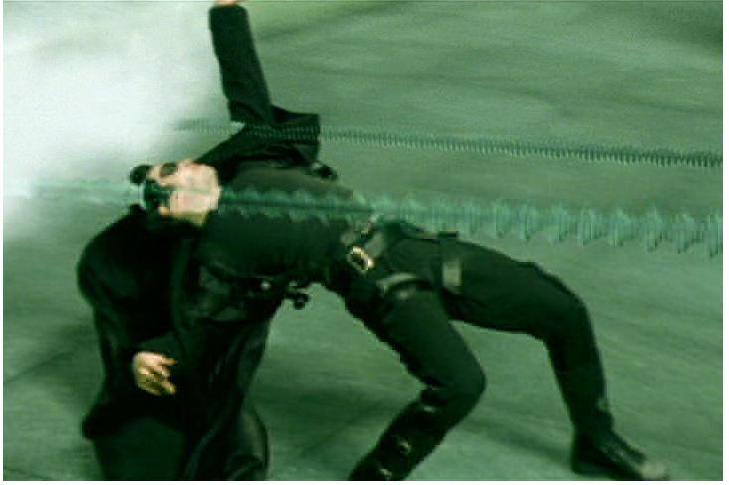
4) Staging
Staging is the presentation of an idea so that it is completely and unmistakably clear.
To stage an idea clearly, the audience's eye must be led to exactly where it needs to be at the right moment.
The object of interest should contrast from the rest of the scene.
Example: slow motion, frozen time.

Slide 27
5) Follow through
Follow through is the termination of an action.
Actions very rarely come to a sudden and complete stop, but are generally carried past their termination point.
Example: When Snow White starts to dance, her dress does not begin to move with her immediately but catches up a few frames later.

Slide 28
6) Slow In and Out
In reality, nothing starts in motion suddenly with no acceleration. Even a bullet shot from a gun has a short period of acceleration.
Ease-in and ease-out is the acceleration and deceleration of an object in motion. Eases may be applied to any motion track, whether it is rotation, scaling, color or translation.

Slide 29
7) Arcs
Most living creatures move in curved paths, NOT in perfectly straight lines.
  Example:
    arm movement
    head turns
    eye movements
Non-arc motion - > restricted or robotic effect.
  Example:
    Robots

Slide 30
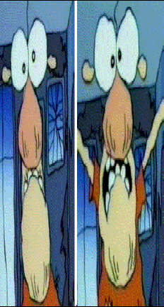
8) Exaggeration
Emphasize an idea so the audience can see it.
Can emphasize on:
  facial features
  Expressions
  Poses
  Attitudes
  actions.
If a character is sad, make him sadder; if he is happy, make him shine.

Slide 31
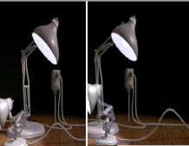
9) Secondary Action
Secondary action consists of the smaller motions that complement / re-enforcing the dominant action.
Example
  when a plug is forcedly pulled, the wire will be straight at first and then curled when the plug is out.
Secondary actions are important in adding a realistic complexity to the animation.

Slide 32
10) Appeal
Appeal: the personality of the character*.
  *Character could be hero, villain, joker, cute, pretty.
Allows the emotional connection between character and audience.
Appeal also includes easy to read design, clear drawing & personality development that will capture interest.
  Example:
    How the character moves, reacts to different situations defines the personality / appeal

Slide 33
11) Strong Drawing or Solid Drawing
Solid drawing in conventional animation refers to the fact that the characters should be drawn in such a way that they look 3-D.
In computer generated animation, solid drawing applies to the design of the character. One should design a character such that it is flexible enough to do the action that the story requires without appearing stiff or awkward.

Slide 34
12) Straight Ahead Action & Pose-To-Pose Action
Straight ahead Action:
  Starts at the first drawing then works drawing to drawing to the end of a scene.
  Fast, wild action scenes are done this way.
Pose-To-Pose Action:
  planned out and charted with key drawings (keyframes) done at intervals throughout the scene.
  Allows control on size, volumes, and proportions of the animation.

Slide 35

Animated GIFs
247–249
Sequence of images can be stored in a single GIF file, and displayed one after another by a Web browser or other software
No browser plug-in required
Can specify looping, delay between frames
256 colour palette
No sound

Slide 36
SWF
254
Popular Web animation format
Usually generated by Macromedia Flash
Vector animation format
Motion represented as numerical operations on vector data
Can also include bitmapped images (e.g. as backgrounds)

Slide 37
Summary
1. Animation is the rapid display of a sequence of images of artwork or model positions or frames in order to create an illusion of movement.
2. Types of animation:
- Bitmap animation
- Vector animation
Common techniques of animation:
- Keyframe animation
- Cel-based animation
- Path-based animation
4. 3 steps of 3-D animation:
  - Modeling
  - Animation
  - Rendering

Slide 38
Summary
5. Animation special effects:
- Ray tracing
- Morphing
- Warping
  6. Kinematics is the study of movement & motion of structures that have joints. (example: a walking man, dinosaur).
  7. Inverse kinematics is the process that links object (eg: hands to arm) to define relationship and limit. (kinematic constraints & kinematic chain)
  8. 12 principals of animation include: Squash and Stretch, Timing and Motion, Anticipation, Staging, Follow Through and Overlapping Action, Straight Ahead Action and Pose-To-Pose Action, Slow In and Out, Arcs, Exaggeration, Secondary Action, Appeal, Strong Drawing or Solid Drawing

